Slide 1
CS M51A Discussion #3
Hyunjin Kim

Slide 2
Outline
Voltage Divider
BJT
CMOS
Adder
Decoder / Encoder

Slide 3
HW1 Grading
1~16: each 5 points
17~18: each 10 points
Grader
1~6: Akanksha (2A)
7~12: Nazanin (2B)
13~16: Hyunjin (2C)
17~18: Daniel (2D)

Slide 4
Homework Submission
Don’t forget to put your section number
Please staple your homework
Put your answers in order
Write your answer in large enough size
Use single column
Tip
show your work as much as possible

Slide 5
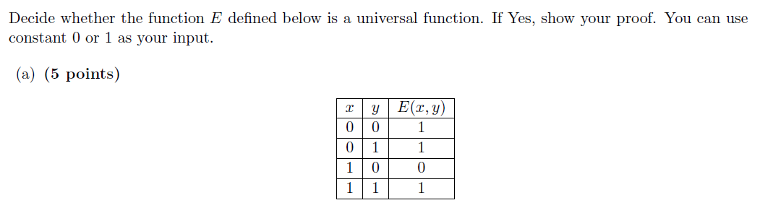
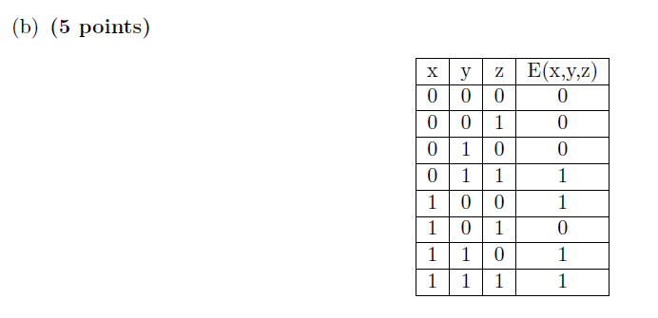
E(x, y) = x’ + y
NOT: E(x, 0) = x’
OR: E(E(x,0), y)= E(x’, y) = x+y
E(x, y, z) = x’yz+xy’z’+xyz’+xyz
= yz + xz’
NOT: E(1, 0, z) = z’
AND: E(0, y, z) = yz

Slide 6


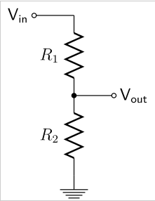


Voltage Divider
Q1. Vin = 9V, Vout=? If R1=R2
Q2. Vin = 9V, Vout=6V, What is R1:R2?

Slide 7
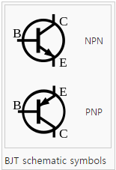
Bipolar Junction Transistor
NPN BJT transistor
Act as a switch
Closed if B is 1
Opened if B is 0
PNP works reversely
Resister
Prevent short circuit
Put the resistor on the path having no transistor

Slide 8
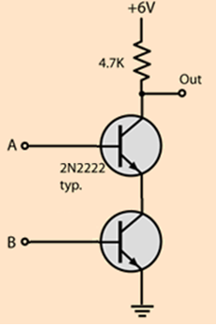
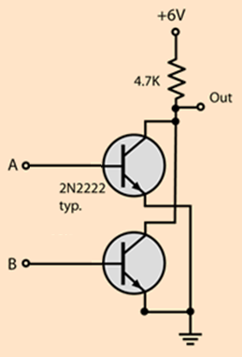
Gate Implementation with BJT
2-input NAND
2-input NOR

Slide 9
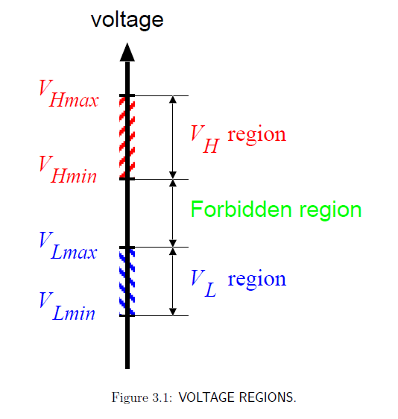
Voltage Regions

Slide 10
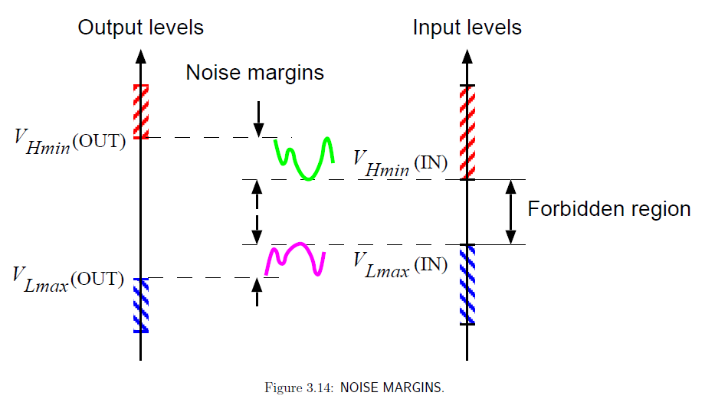
Voltage Variations & Noise Margins

Slide 11
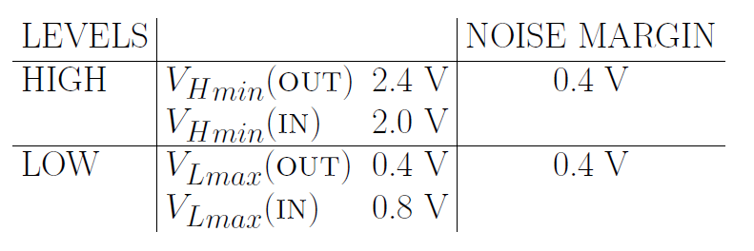
Noise Margin Example

Slide 12
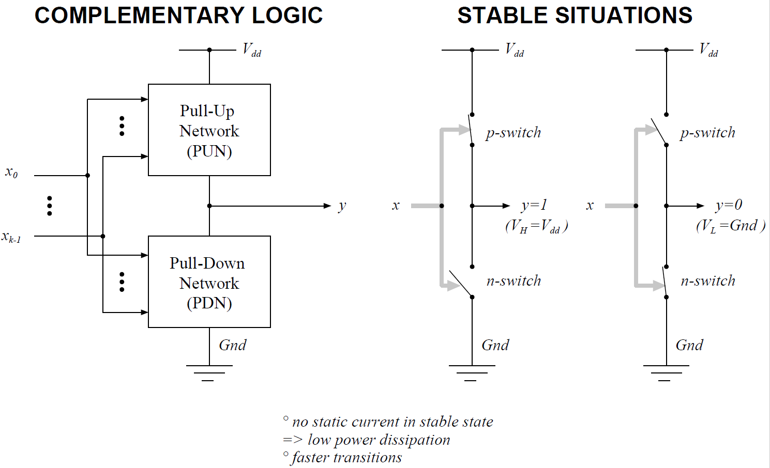

Slide 13
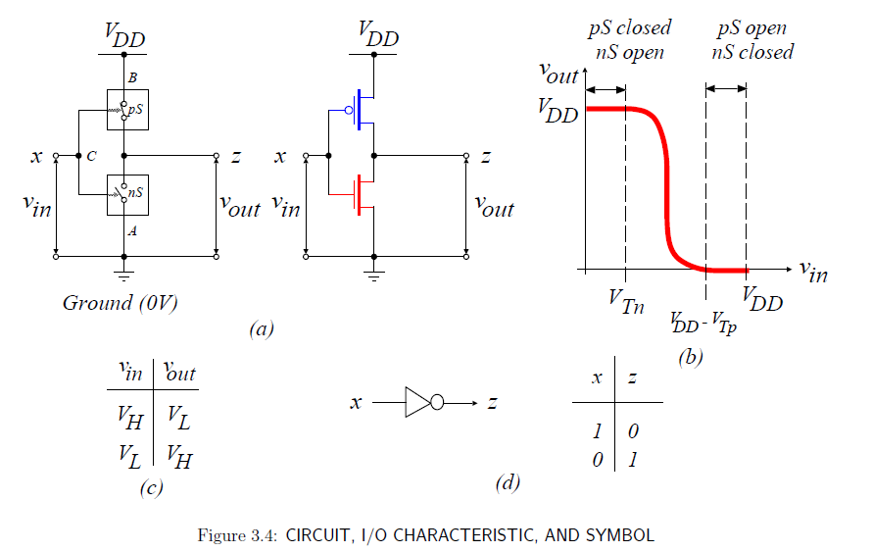
CMOS NOT Gate

Slide 14
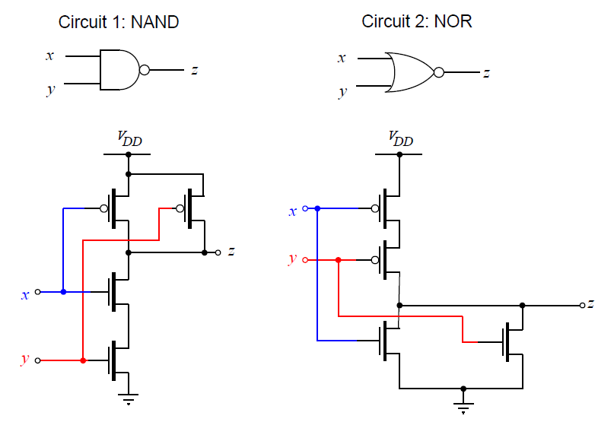
CMOS NAND & NOR Gate

Slide 15
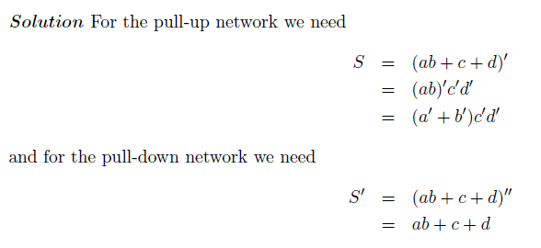
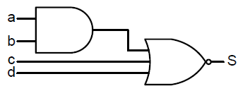
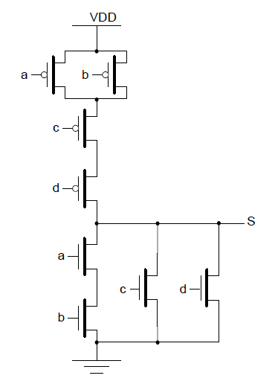
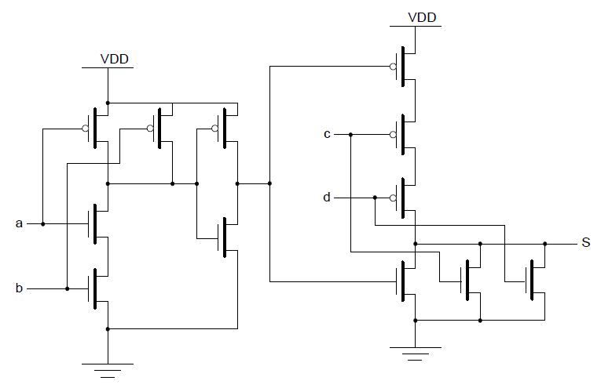
Draw the CMOS circuit implementation for the following gate 1. Using Separate AND and NOR gate implementation 2. A single complex gate.
2
1

Slide 16
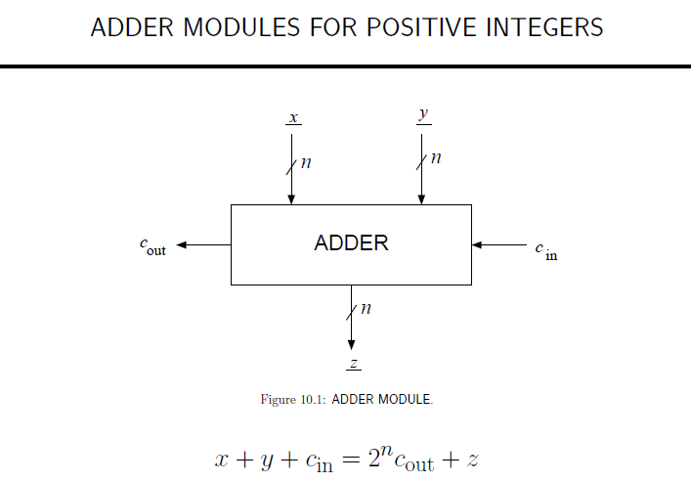

Slide 17
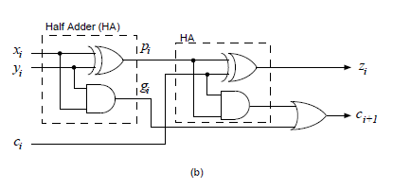
Basic Adder Unit (FA)

Slide 18
Various Adders Impl.
Ripple Carry Adder
Carry Look-ahead Adder (opt.)
Carry Select Adder (opt.)
Carry Skip Adder
Pipelined Adder
Manchester carry chain adder
…

Slide 19
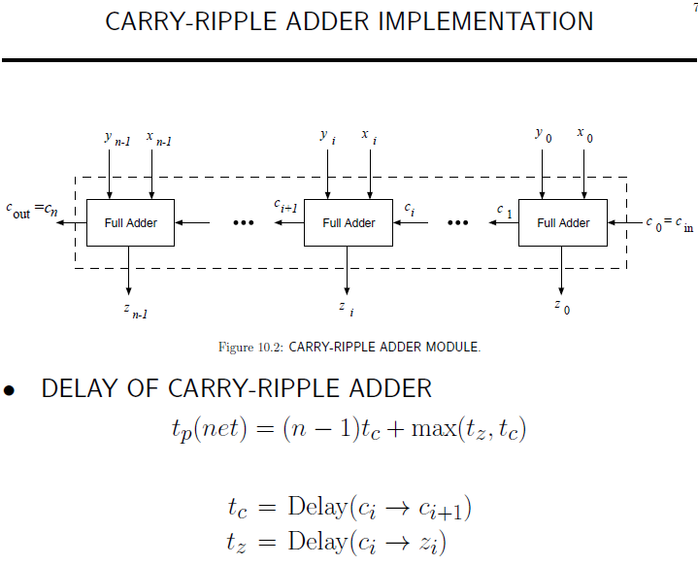

Slide 20
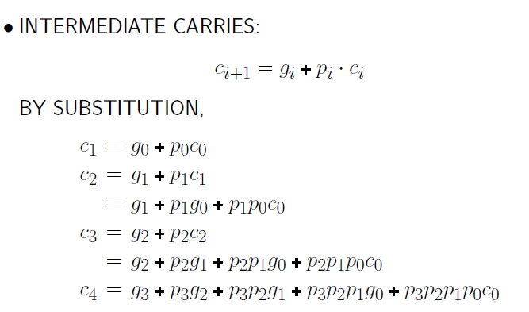
Carry-Lookahead Adder
gi = xi AND yi
pi = xi XOR yi

Slide 21
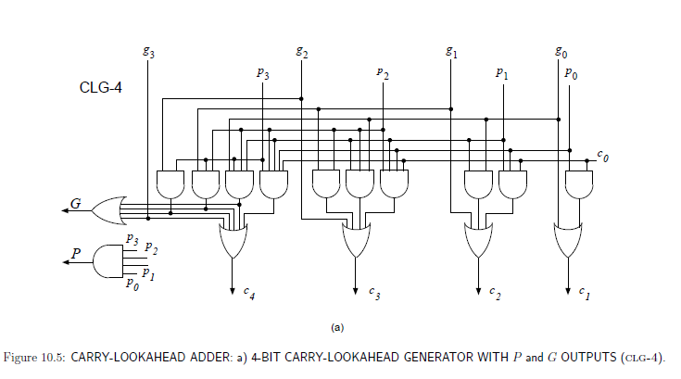
Carry-Lookahead Adder

Slide 22
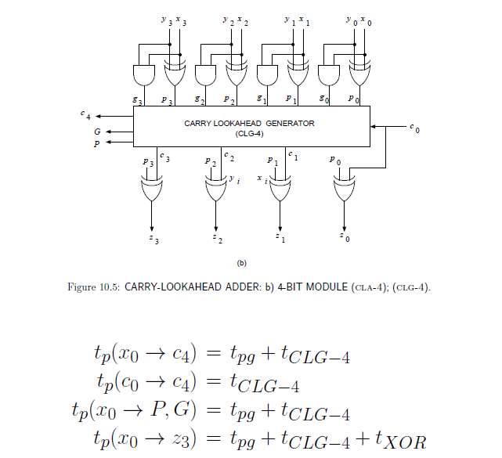
Carry-Lookahead Adder

Slide 23
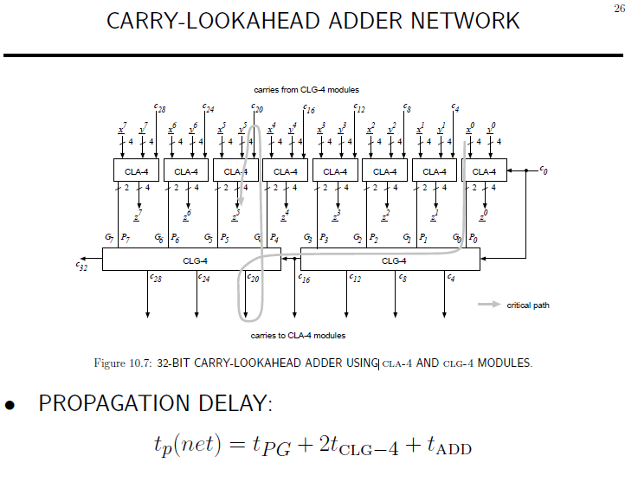

Slide 24
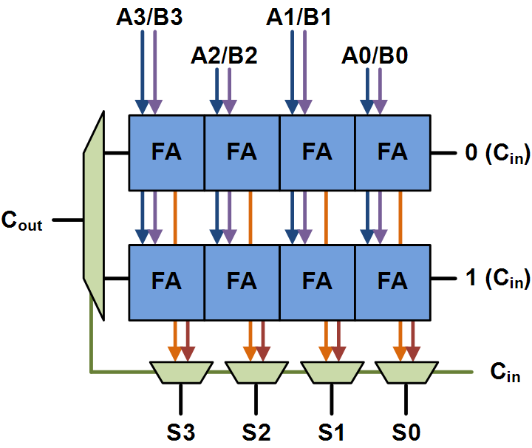
Carry Select Adder

Slide 25
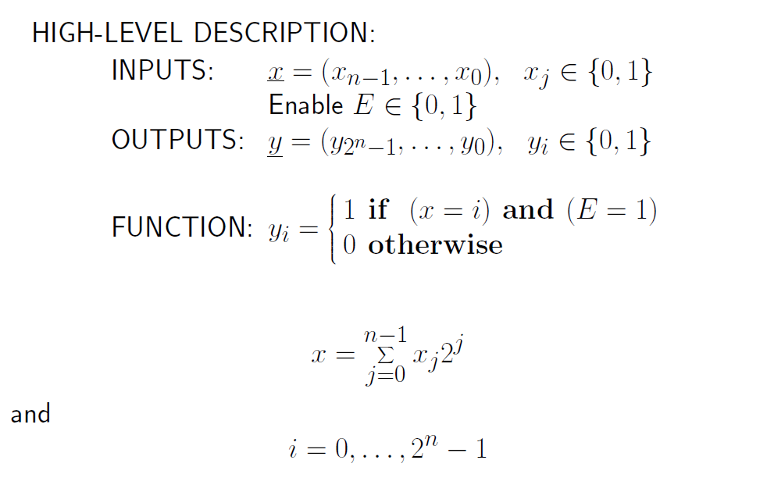
Binary Decoder

Slide 26
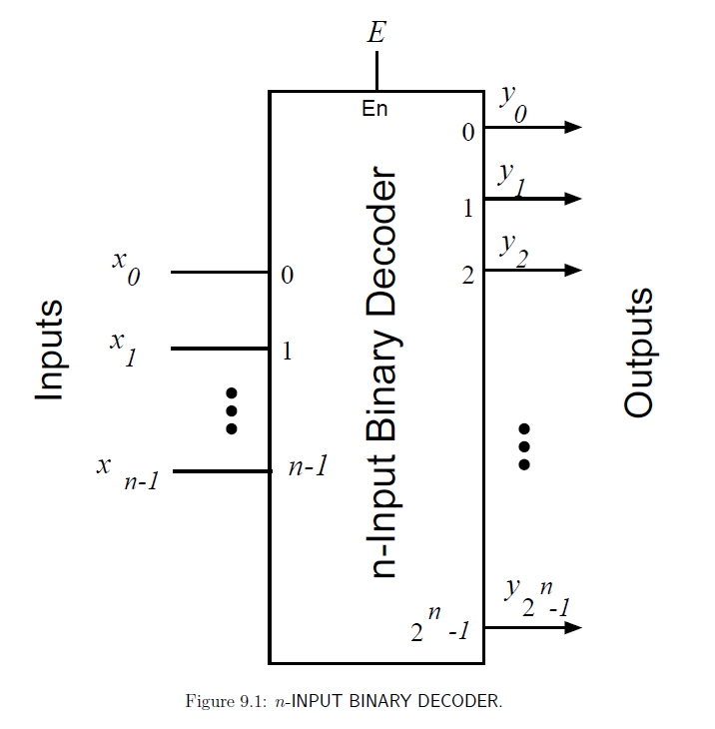

Slide 27
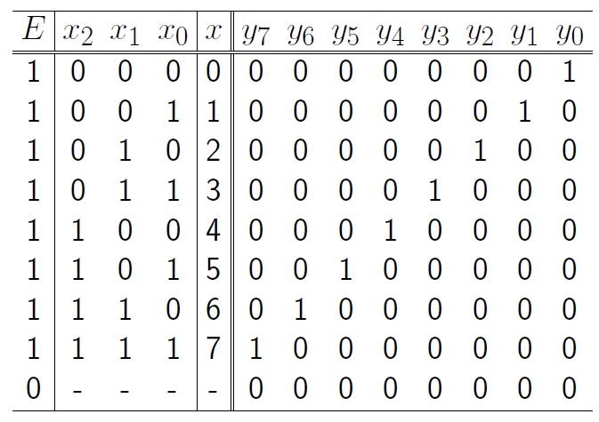
3-input Binary Decoder

Slide 28
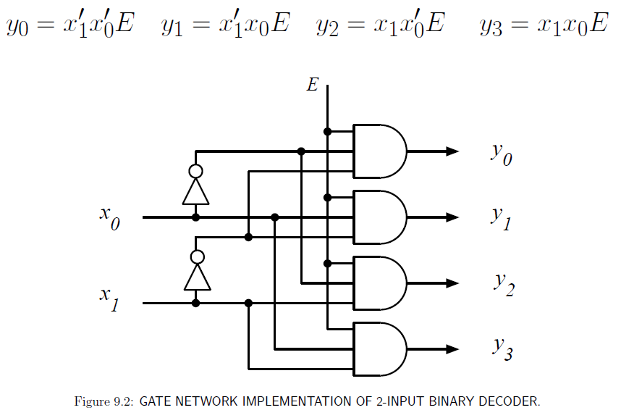

Slide 29
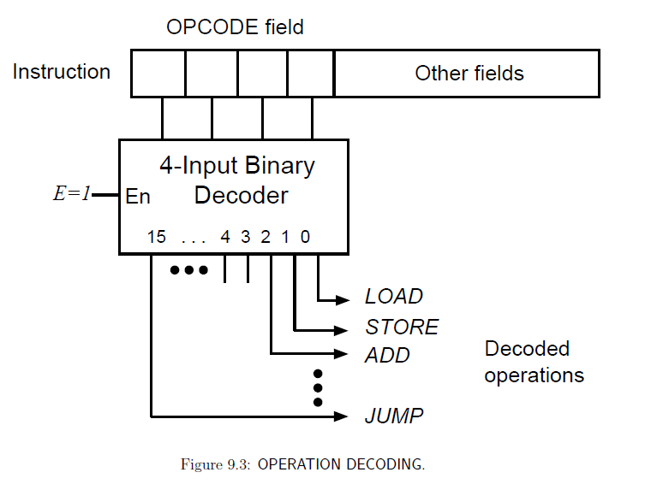
Uses of Decoder

Slide 30
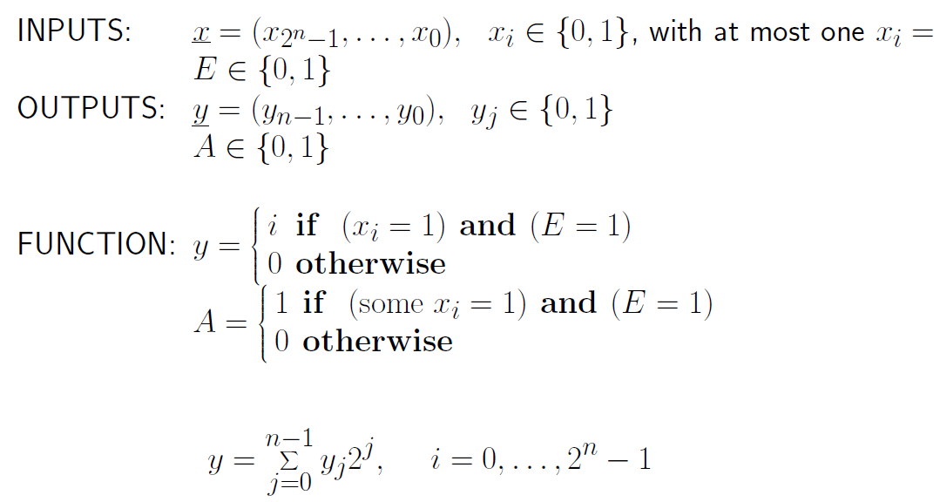
Binary Encoder

Slide 31
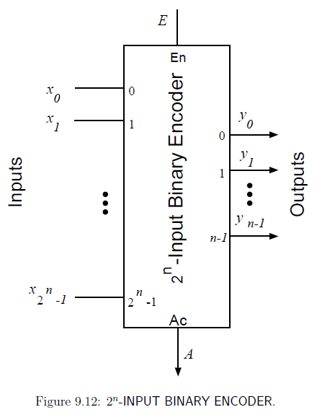

Slide 32
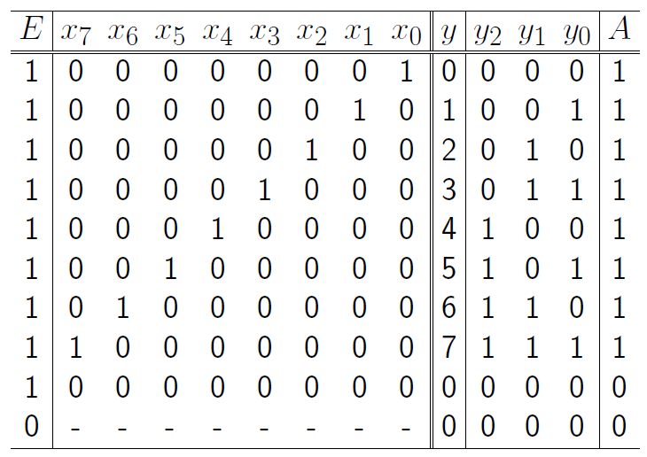
8-input Binary Encoder

Slide 33
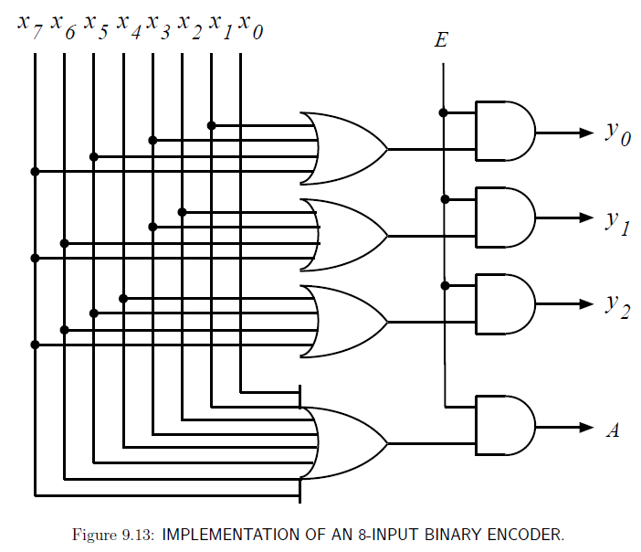

Slide 34
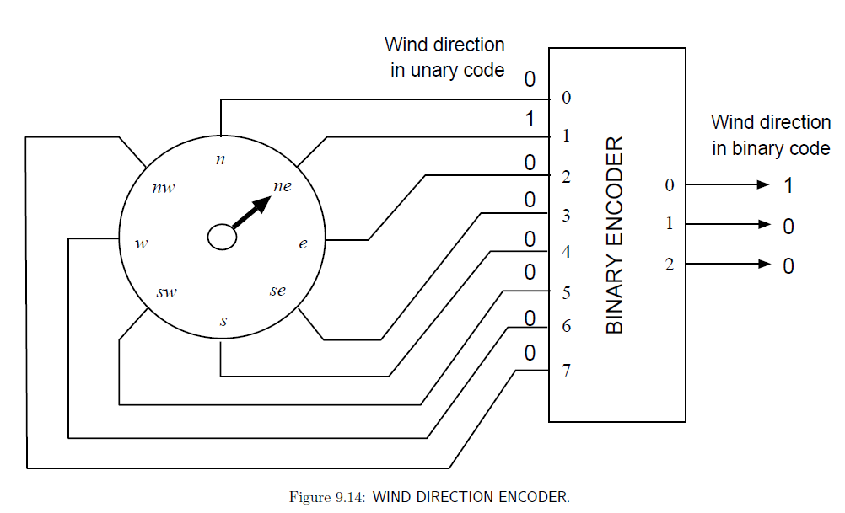
Uses of Encoder

Slide 35
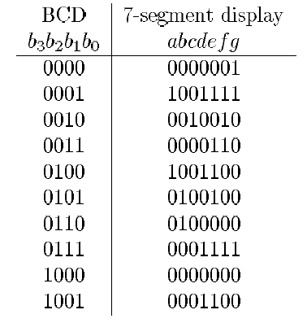
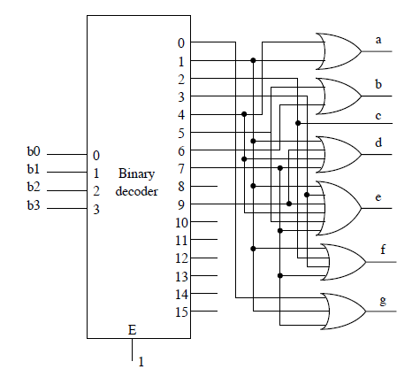
1.(a) BCD to 7-segment code converter

Slide 36
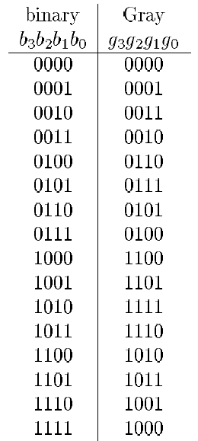
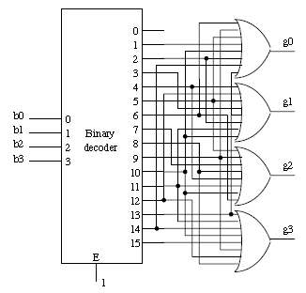
1.(b) 4-bit binary to 4-bit gray code converter

Slide 37
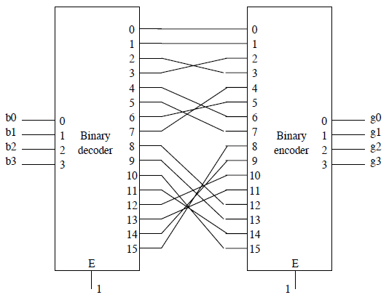
extra) 4-bit binary to 4-bit gray code converter using decoder and encoder

